Slide 1
Pakistan Ecommerce Customer Segmentation Analysis
Group B

Slide 2
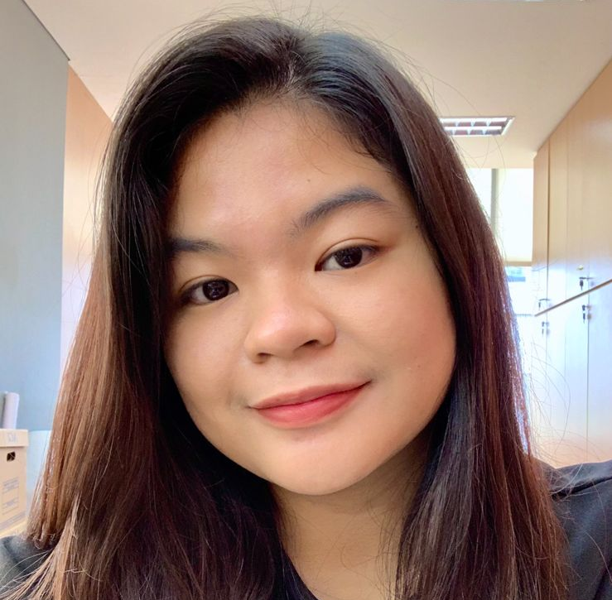

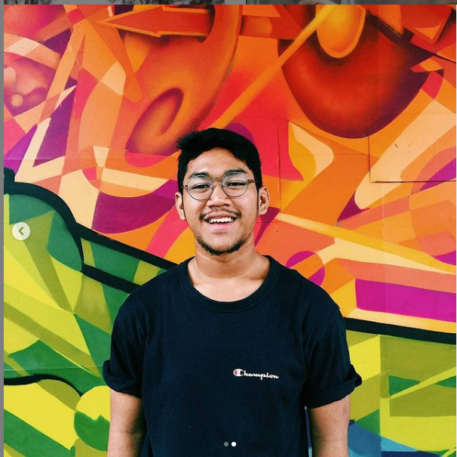
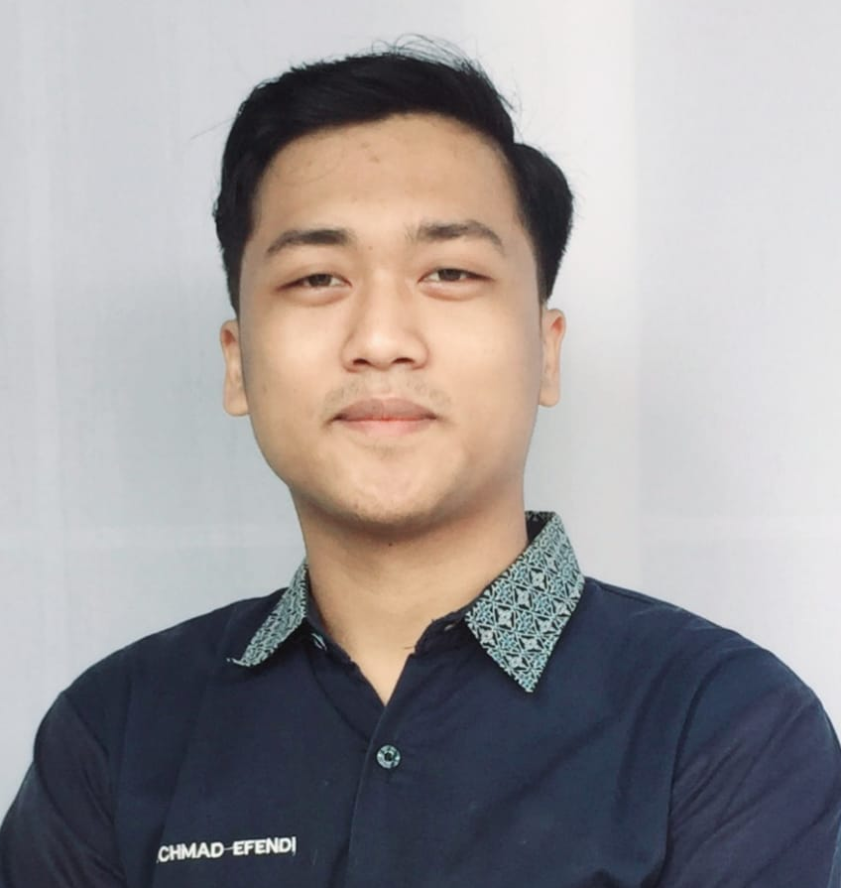
Team Members
1
2
3
4
Ayu
Fauzan
Izzan
Ruseva

Slide 3
Company Overview
Pakistani Ecommerce is one of technology company mainly focusing in ecommerce. The business covers three key areas - ecommerce, logistics, and payment infrastructure which provides an end-to-end ecommerce solution for our sellers and customers. Throughout the year of 2016 - 2018, here is the highlight of the company;
140K+
730+ millions
70K+
Gross Merchandise Value
Customers
Products Sold

Slide 4
Executive Summary
1
The total sales have been inconsistent throughout 2016 - 2018.
In November, the total sales always experience drastic increase because of Black Friday events, but it cannot be maintained since it decreases dramatically afterwards.
2
3
The target expectations for next year is to increase the total sales in every months apart from November.
4
To achieve these expectations, we create a customer segmentation in order to make more effective marketing strategy that targets a specific customer segmentation.

Slide 5
Methodology
1
2
Data Preparation
Data Cleaning
Collecting data from Kaggle and recognizing the data type.
Cleaning the data using Python and Google Sheets
3
4
Data Analysis
Data Visualization
EDA and RFM Analysis using Python and Tableau
EDA Visualization and Dashboard creation using Tableau

Slide 6
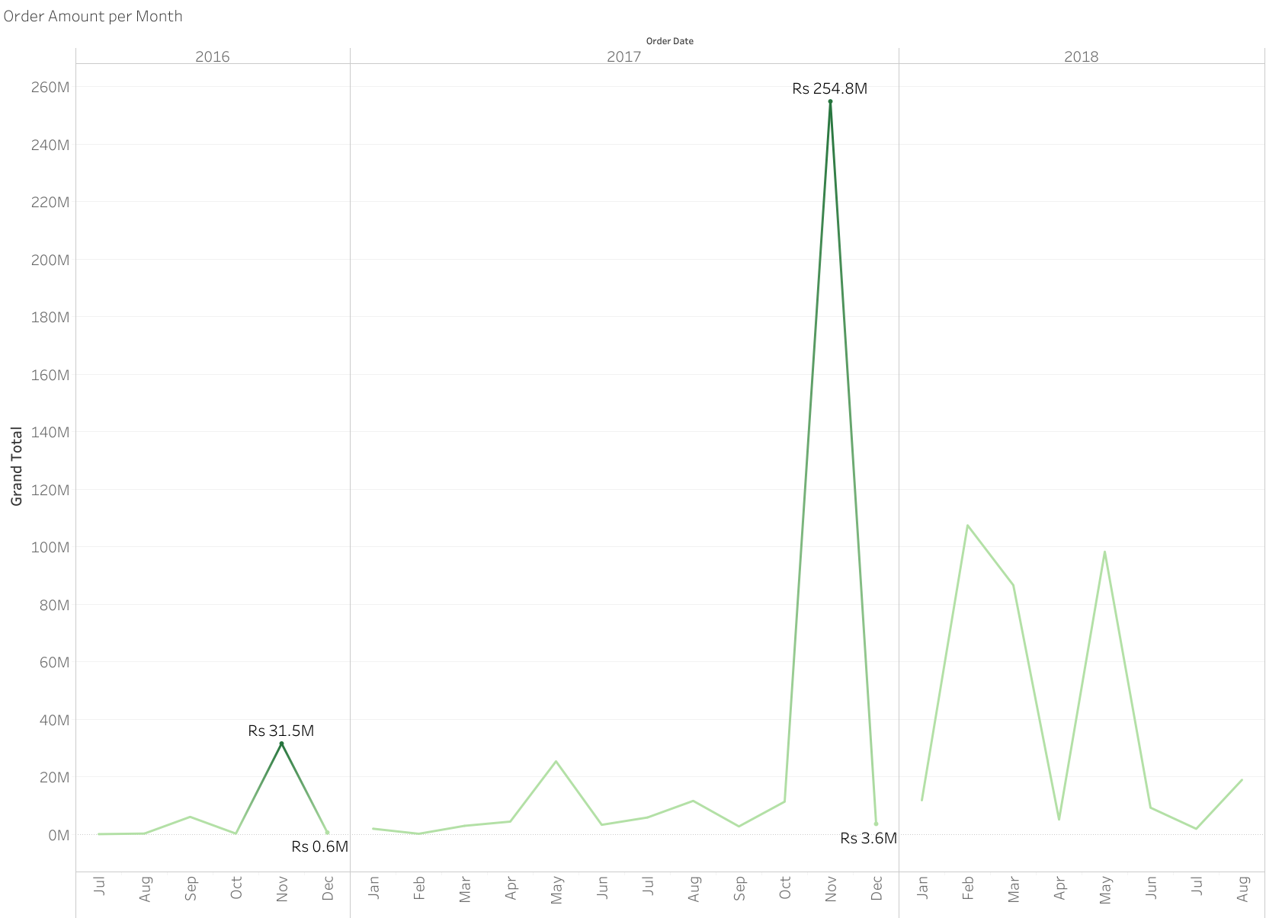
Problem Statement
Sales trend show a inconsistent improvement trend throughout 2016 - 2018.
In November, the total sales always experience drastic increase because of Black Friday events. However, a drastic decrease in total sales also seen in the next months. High sales on Black Friday looks like it can't be maintained.

Slide 7
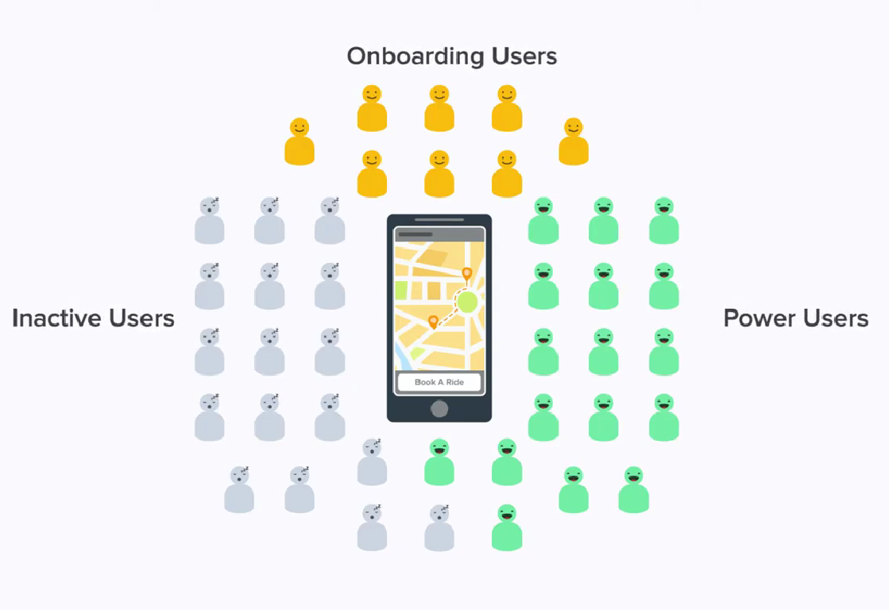
Possible Cause
Marketing power is still not focused on power users and wasted on inactive users. So that the sales trend cannot be maintained on the next month.

Slide 8

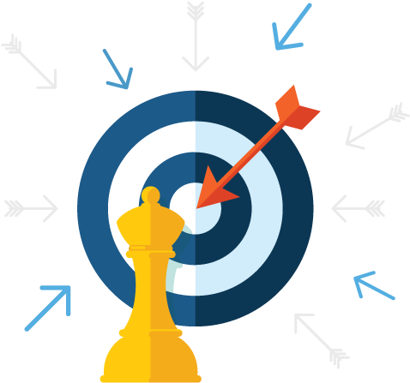

Objectives
Increase the total sales in every months by targeting marketing.
Maintain Customer so High sales on black friday looks like it can be continued the next day.
Create a customer segmentation in order to make a more effective marketing strategy with RFM analysis.

Slide 9
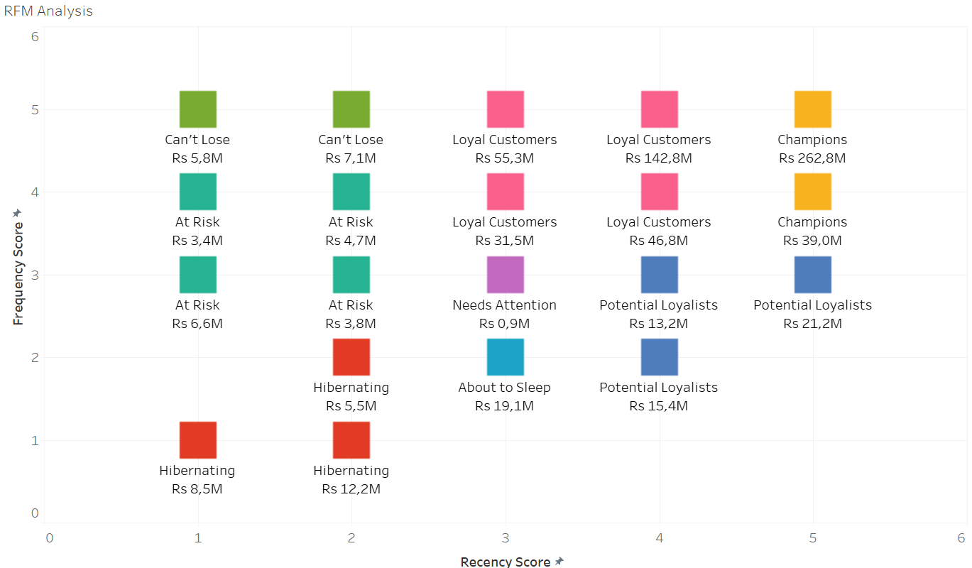
RFM Segmentation
RFM stands for Recency, Frequency, and Monetary value, each corresponding to some key customer trait. These RFM metrics are important indicators of a customer’s behavior because frequency and monetary value affects a customer’s lifetime value, and recency effects retention, a measure of engagement.
Score 5 : The best
Score 1 : The worst

Slide 10
Can’t Lose
1
Can’t Lose
4.790 Customers
Rs 3.24K spending average
Recency 498 Days
Need Attention & About to Sleep
Need Attention : 170 Customers
About to Sleep : 2.094 Customers
Need Attention : Rs 5.98K spending average
About to Sleep : Rs 9.76K spending average
Need Attention : 290 days
About to sleep : 287 days
2
3
Champions
24.722 Customers
Rs 12.60K spending average
98 days
4
Loyal Customers
22.649 Customers
Rs 12.51K spending average
250 days

Slide 11
Need Attention & About to Sleep
1
Can’t Lose
4.790 Customers
Rs 3.24K spending average
Recency 498 Days
Need Attention & About to Sleep
Need Attention : 170 Customers
About to Sleep : 2.094 Customers
Need Attention : Rs 5.98K spending average
About to Sleep : Rs 9.76K spending average
Need Attention : 290 days
About to sleep : 287 days
2
3
Champions
24.722 Customers
Rs 12.60K spending average
98 days
4
Loyal Customers
22.649 Customers
Rs 12.51K spending average
250 days

Slide 12
Champions
1
Can’t Lose
4.790 Customers
Rs 3.24K spending average
Recency 498 Days
Need Attention & About to Sleep
Need Attention : 170 Customers
About to Sleep : 2.094 Customers
Need Attention : Rs 5.98K spending average
About to Sleep : Rs 9.76K spending average
Need Attention : 290 days
About to sleep : 287 days
2
3
Champions
24.722 Customers
Rs 12.60K spending average
98 days
4
Loyal Customers
22.649 Customers
Rs 12.51K spending average
250 days

Slide 13
Loyal Customers
1
Can’t Lose
4.790 Customers
Rs 3.24K spending average
Recency 498 Days
Need Attention & About to Sleep
Need Attention : 170 Customers
About to Sleep : 2.094 Customers
Need Attention : Rs 5.98K spending average
About to Sleep : Rs 9.76K spending average
Need Attention : 290 days
About to sleep : 287 days
2
3
Champions
24.722 Customers
Rs 12.60K spending average
98 days
4
Loyal Customers
22.649 Customers
Rs 12.51K spending average
250 days

Slide 14
Recommendation per Segment
1
Can’t Lose
Recommendation :
Notification of new related products
Survey to know why
Used to visit and purchase often, but now have fallen off
2
Need Attention & About to Sleep
Recommendation :
Make limited-time offers
Notification of new related products
Contribute to profitability but don’t make purchase frequently
3
Champions
Recommendation :
Membership & Loyalty Program
Affiliate marketing
Best customer, bought products recently and often, and heavy spenders
4
Loyal Customers
Recommendation :
Membership & Loyalty Program
Upsell higher value products
Recent customer with average frequency and spend good amount

Slide 15
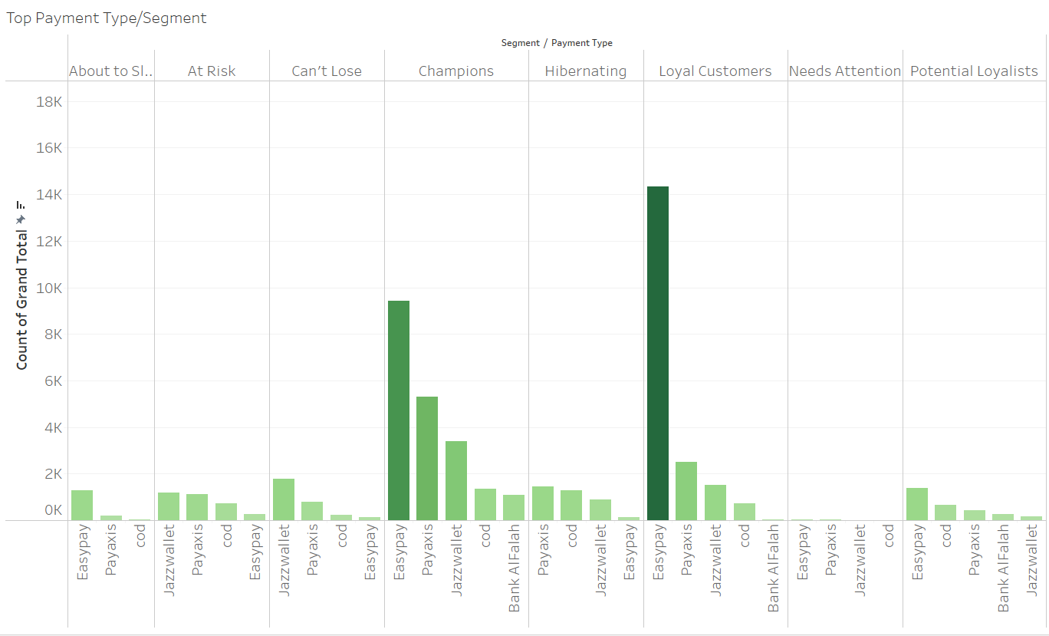
Payment Type per Segment
Can’t Lose
Jazzwallet
Need Attention & About to Sleep
Easypay
Champions
Easypay
Loyal Customers
Easypay

Slide 16
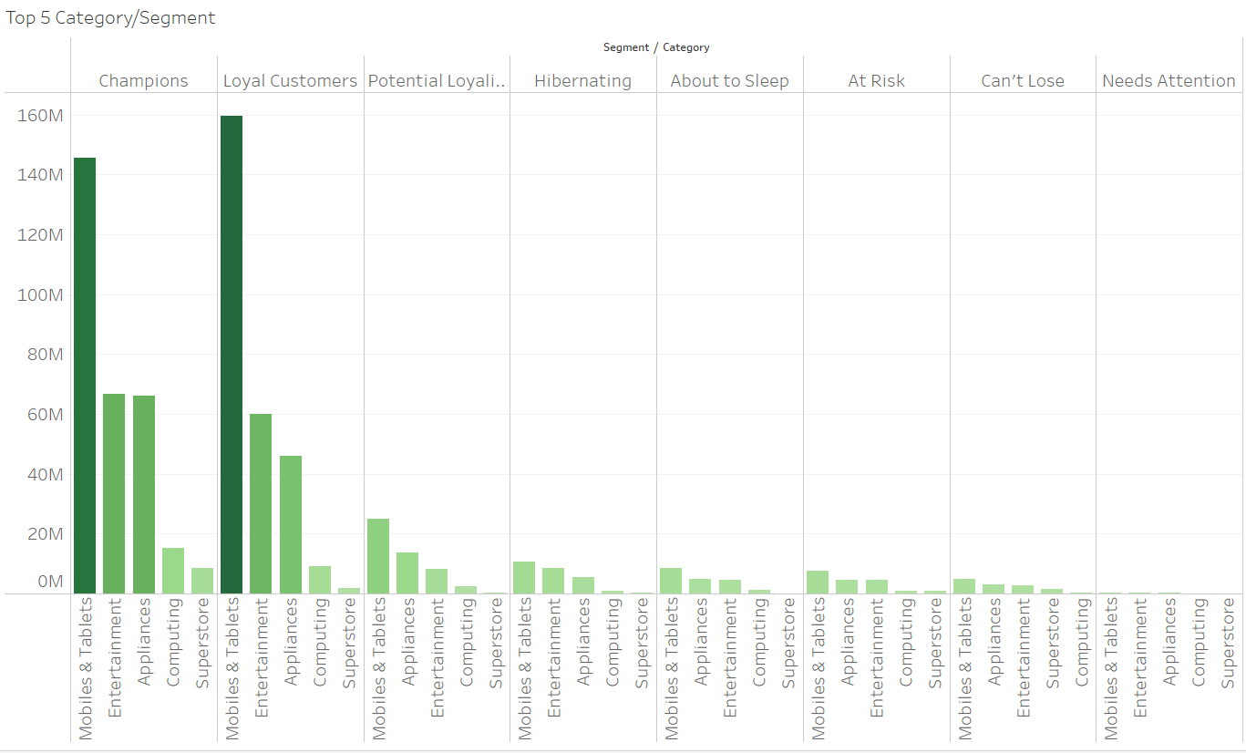
Top 5 Category per Segment
Can’t Lose
Mobile & Tablets
Need Attention & About to Sleep
Mobile & Tablets
Champions
Mobile & Tablets
Loyal Customers
Mobile & Tablets

Slide 17
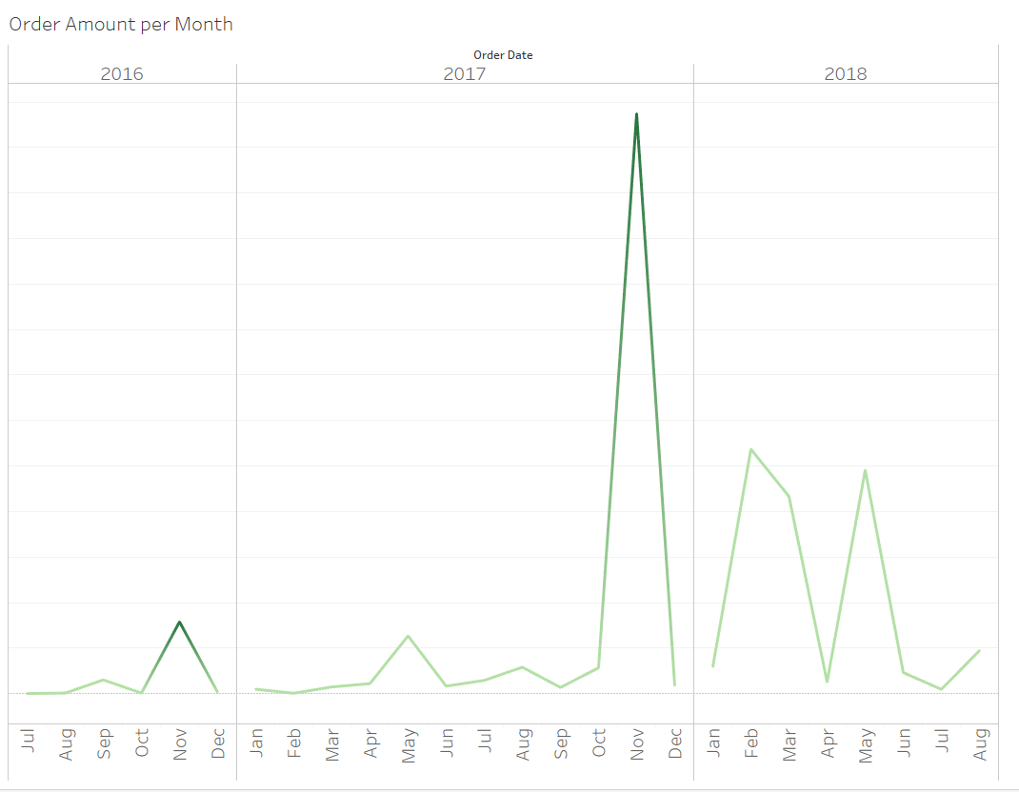
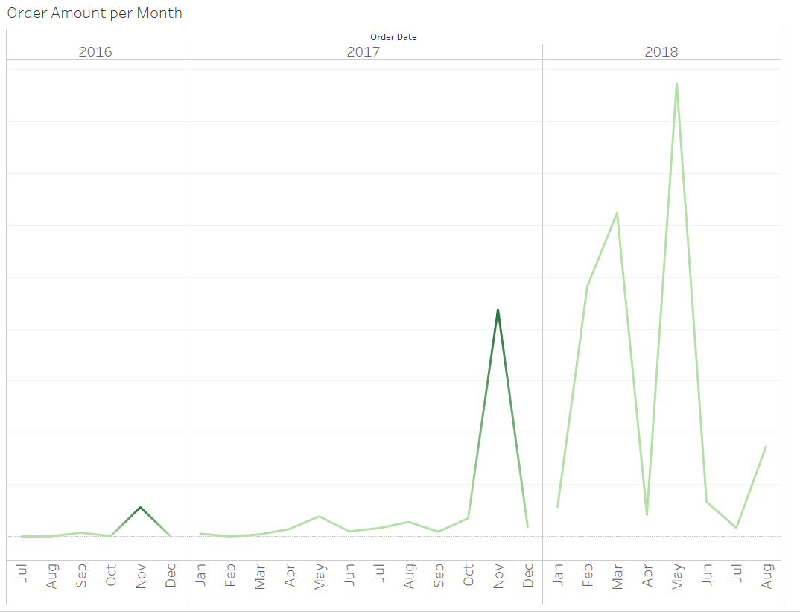
Expected Outcome
Before
Expected
From the targeted marketing, we hope the other customer segmentation has the same type of behaviour as Champions. As it will increase the sale even further.

Slide 18
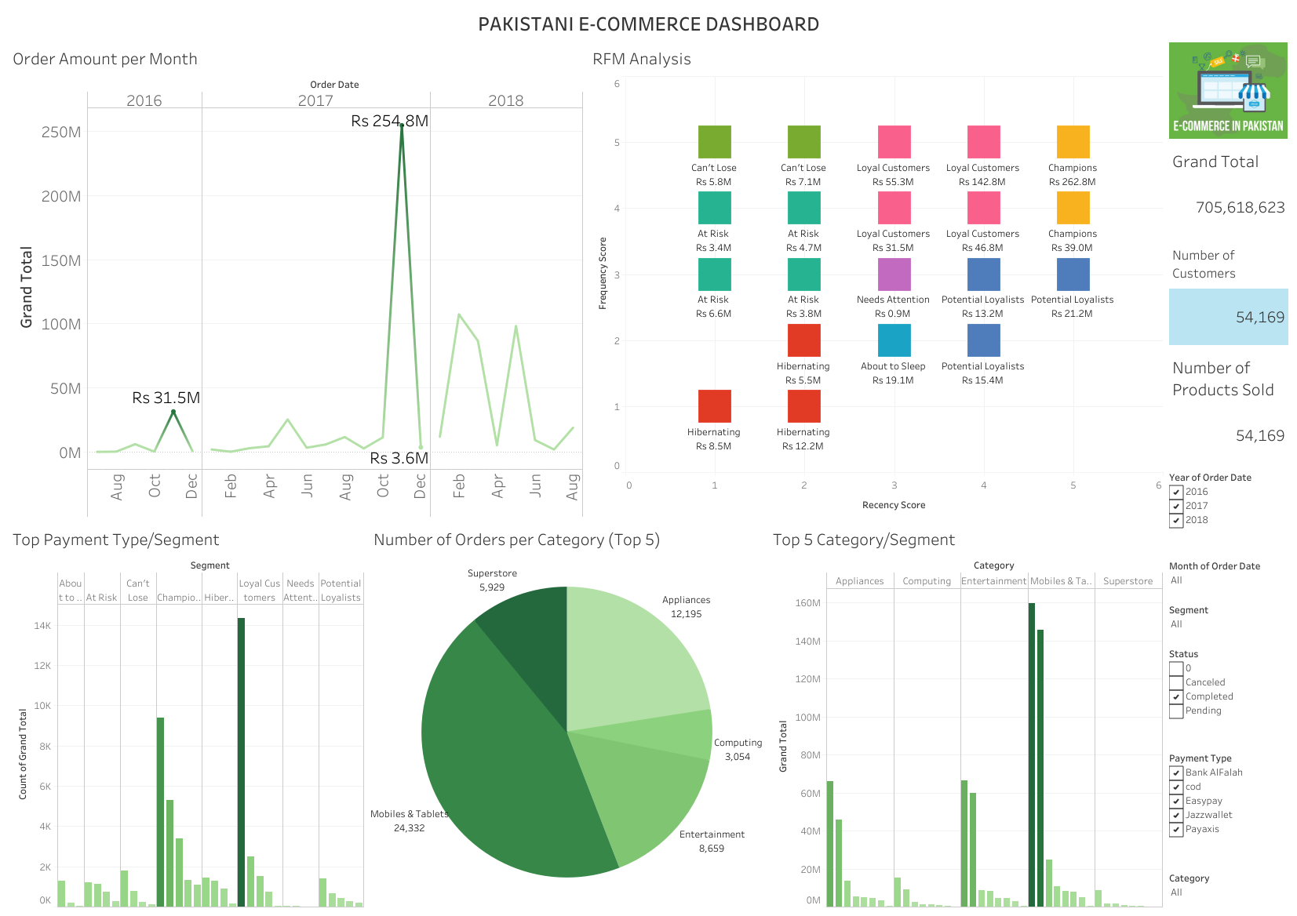

Dashboard
Click the image
for the Dashboard
link

Slide 19
Thank you!

